Slide 1
Is Chain of Thought an Interchangeable Scratchpad?
Shivam Singhal
Homework 0 submission

Slide 2
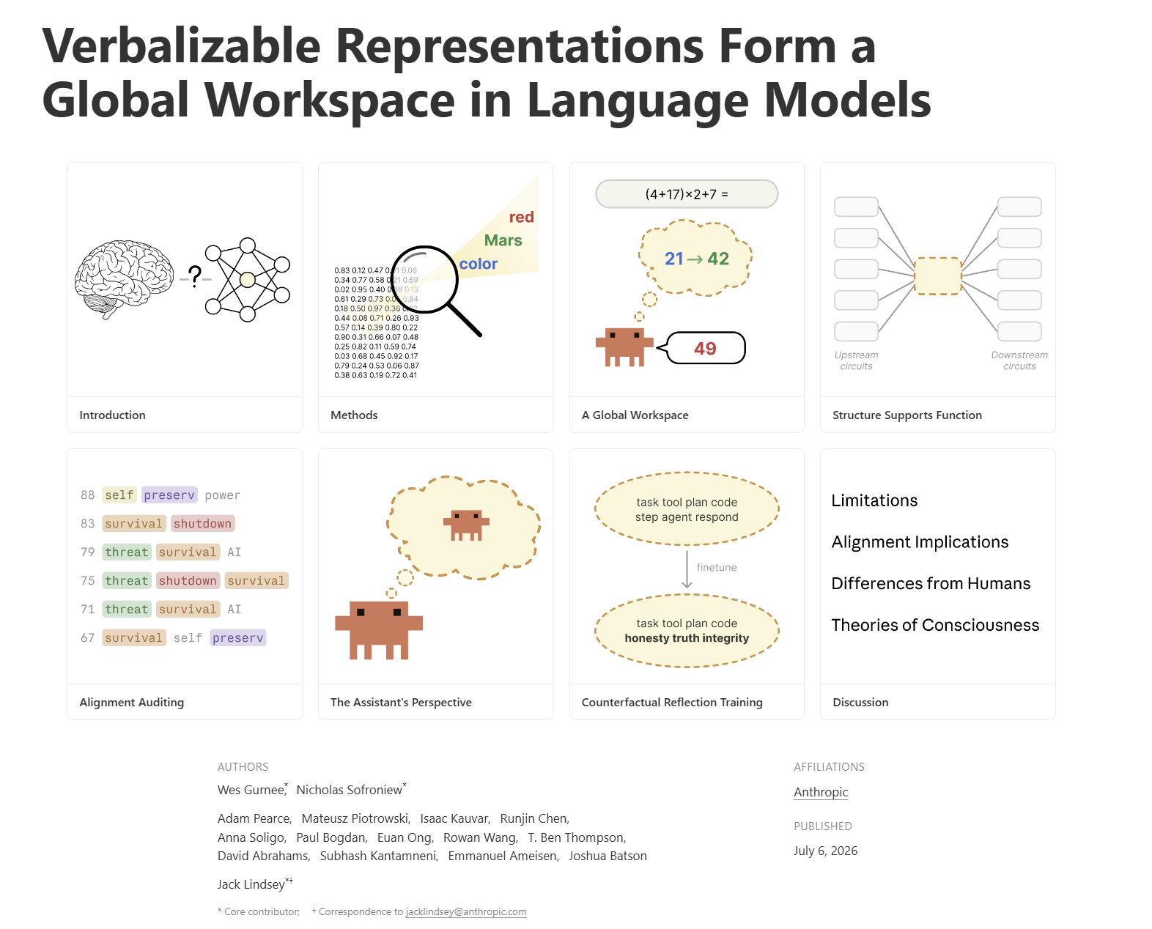
Background

Slide 3
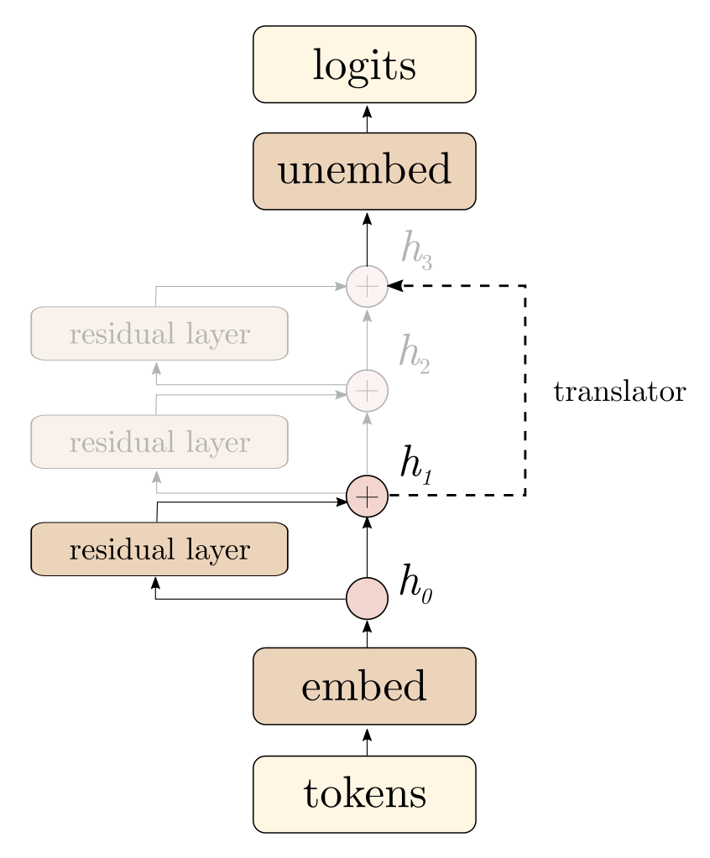
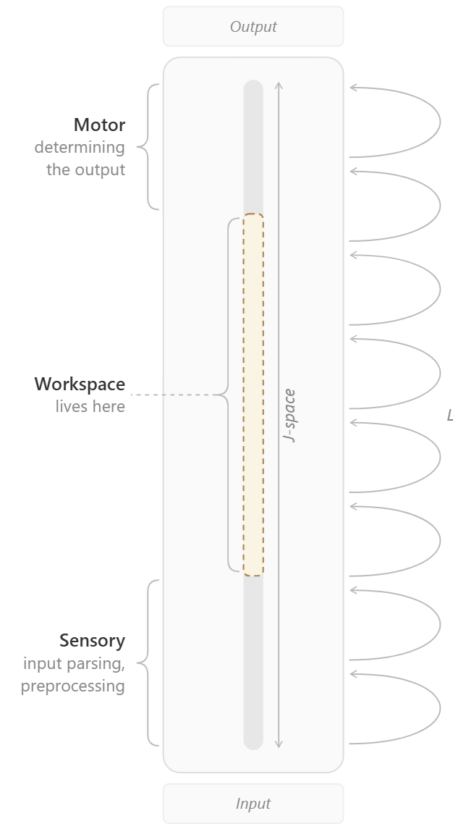
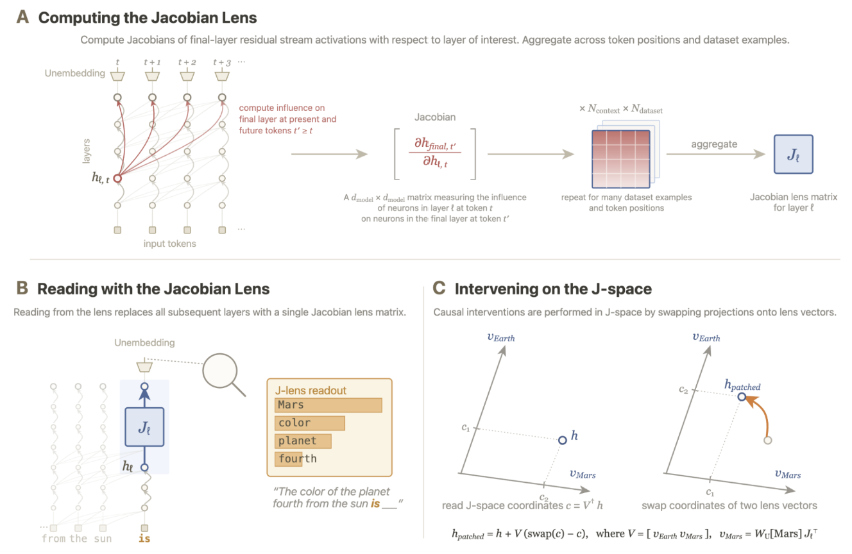
Logit Lens, J-lens and J-Space

Slide 4
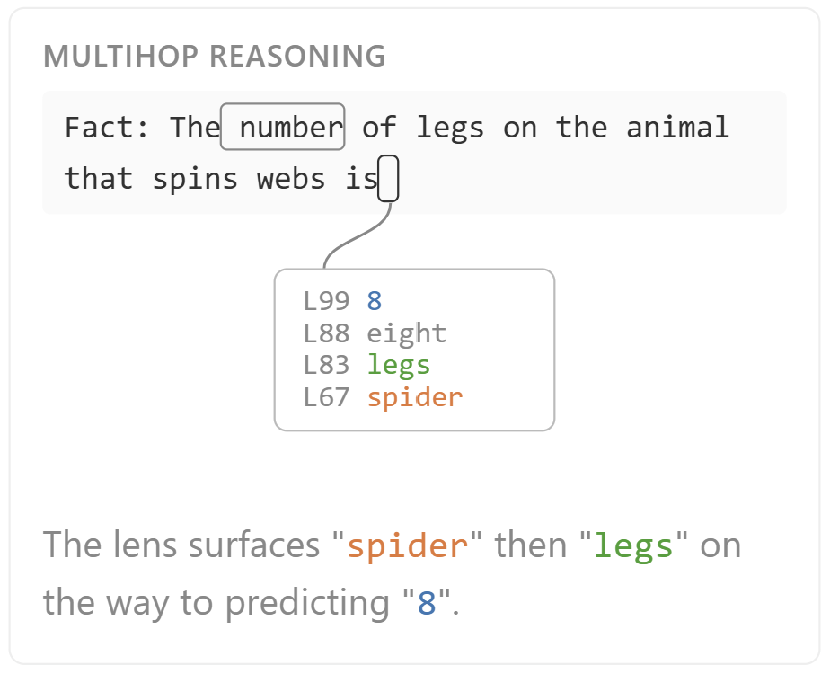
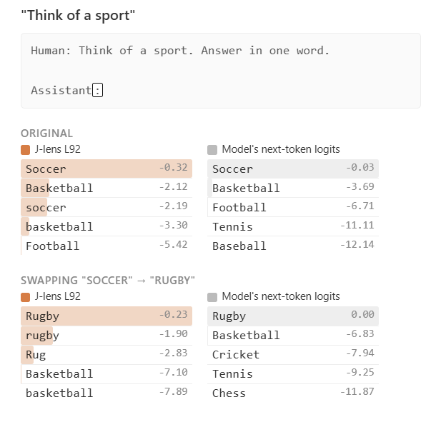
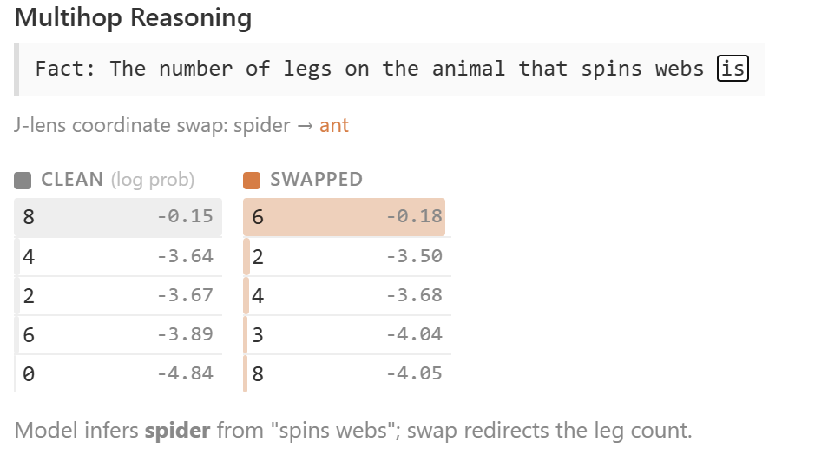
Verbal Report and Internal Reasoning

Slide 5
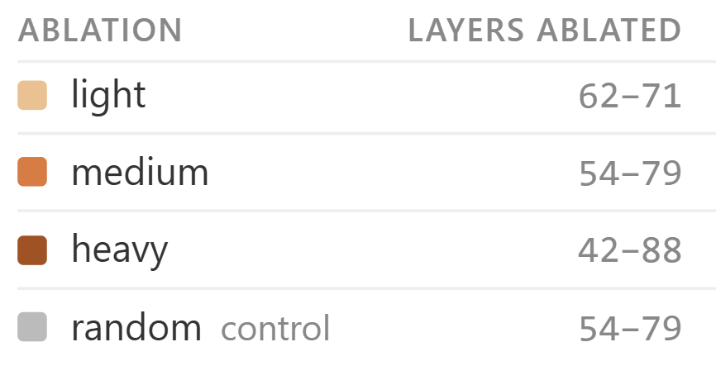
Ablation
At each token position, across a band of layers
Identify k = 10 most strongly activated J-lens vectors & zero out the residual stream’s projection onto each
Then allow forward pass to continue, measure output
NB: did not ablate any tokens that appear in the top-10 tokens of a clean forward pass, to specifically target the J-space’s effects on internal reasoning rather than report

Slide 6
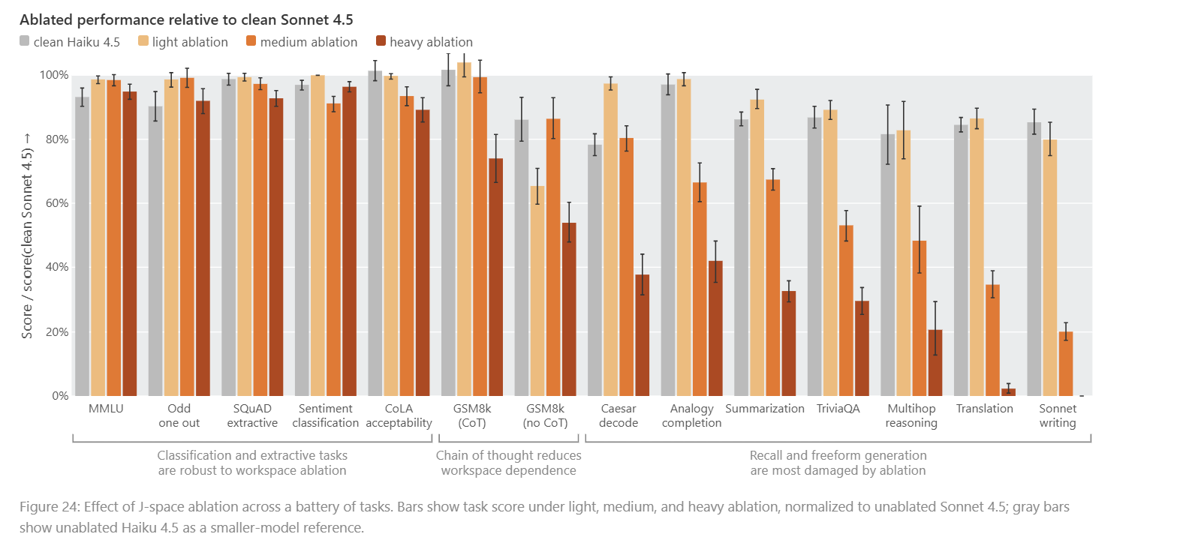
Math evaluation GSM8K solved with explicit chain-of-thought (CoT) is more robust to ablation than the same problems answered directly
*Ablation strengths: Light = L62-71; Medium: L54-79; Heavy: L42-88; Random Ctl: 54-79

Slide 7
How much protection does the explicit chain-of-thought (CoT) provide across problem difficulty and model scale?
Datasets:
  GSM8K
  MATH-500
  AIME
Hypothesis: ablation protection offered by CoT is roughly constant across difficulty.

Slide 8
What is the relationship between the internal and external scratchpads?
(exchange) externalisation actually removes the representation from the J-space.
(duplication) externalisation just duplicates information that continues to be held in the J-space
(complementary) the externalised and internal contents are complementary; a sort of division of labour
(epiphenomenal) the correlation is unrelated to storage altogether. Every generated token buys another forward pass, so the benefit could be extra serial computation instead of any chain-of-thought reasoning

Slide 9
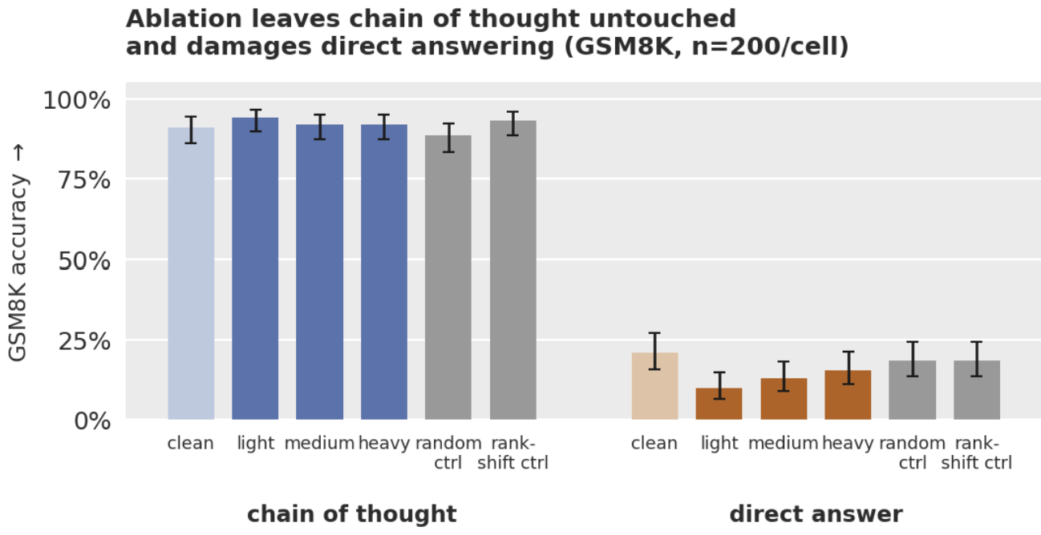
Ablation Experiment

Slide 10
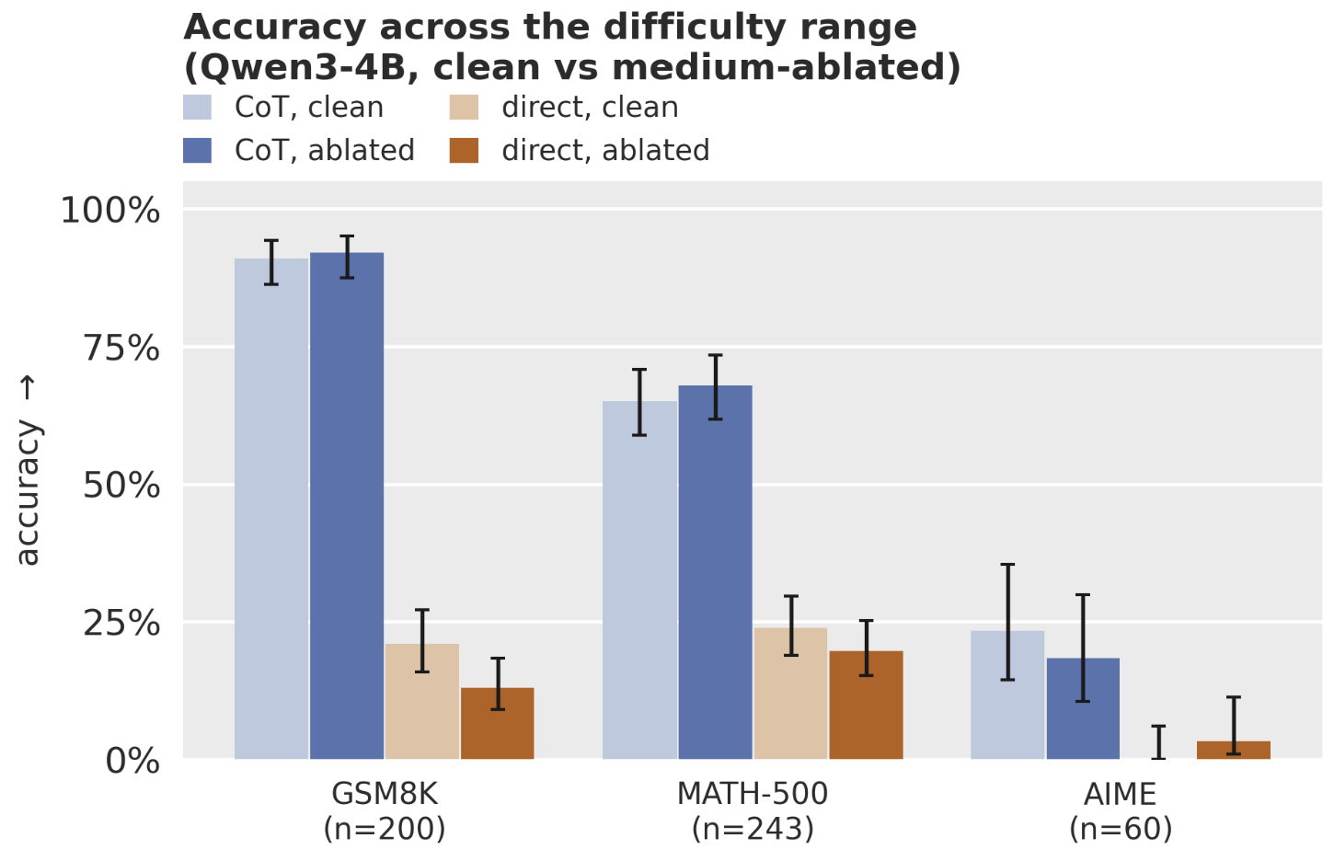
Ablation Experiment

Slide 11
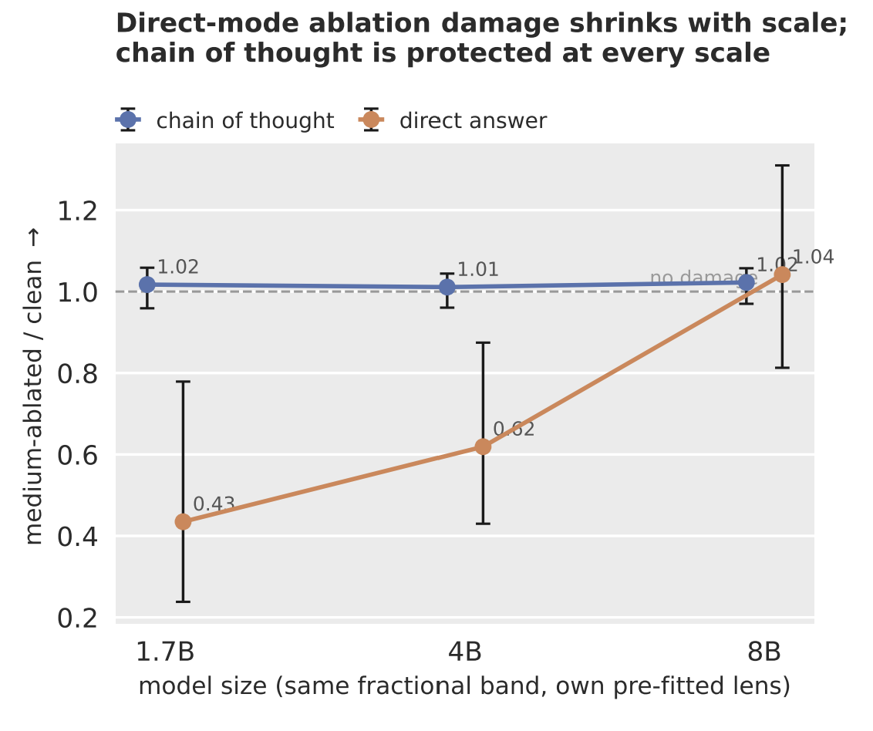
Ablation across model scale
CoT ablation robustness is consistent across task difficulty and model scale

Slide 12
Ruling out epiphenomenalism
If chain of thought helps just because generating tokens buys extra forward passes, then any tokens should help
Experiment:
  Pre-write the model’s scratchpad before letting it answer
  4 different versions:
    1. It’s own correct CoT reasoning
    2. A different problem’s CoT reasoning
    3. Meaningless filler of exactly the same length
      2.1 repeated sentence: “Let me think step by step”
      2.2 The model’s own CoT reasoning tokens shuffled
      2.3 “.” repeated

Slide 13
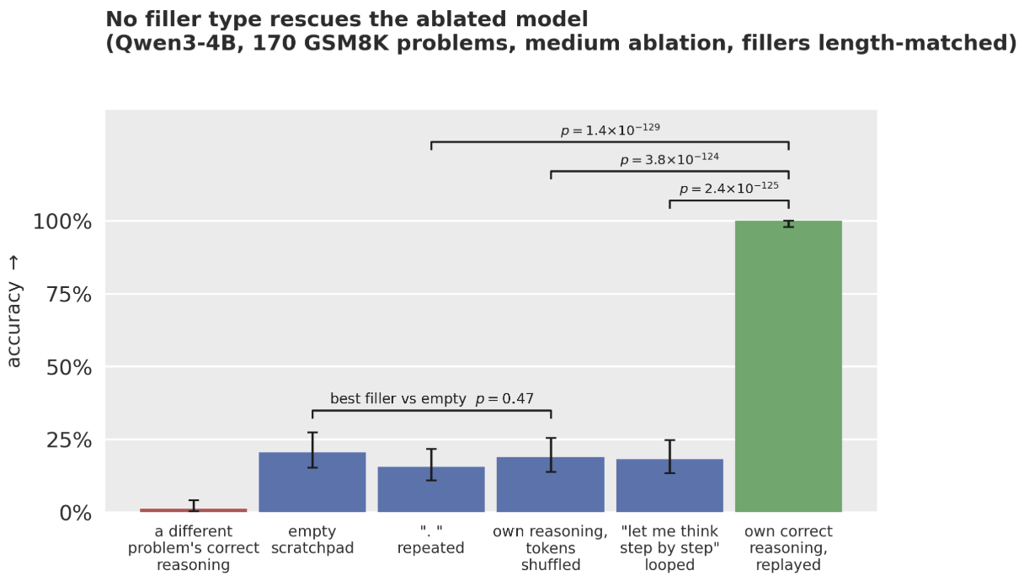
Ruling out epiphenomenalism

Slide 14
Duplication
Does the internal workspace hold content despite CoT-based externalisation?
Experiment:
  A small mathematical problem:
A = 9 – 5
B = 2 + 1
C = 8 – 6
D = A - C

Slide 15
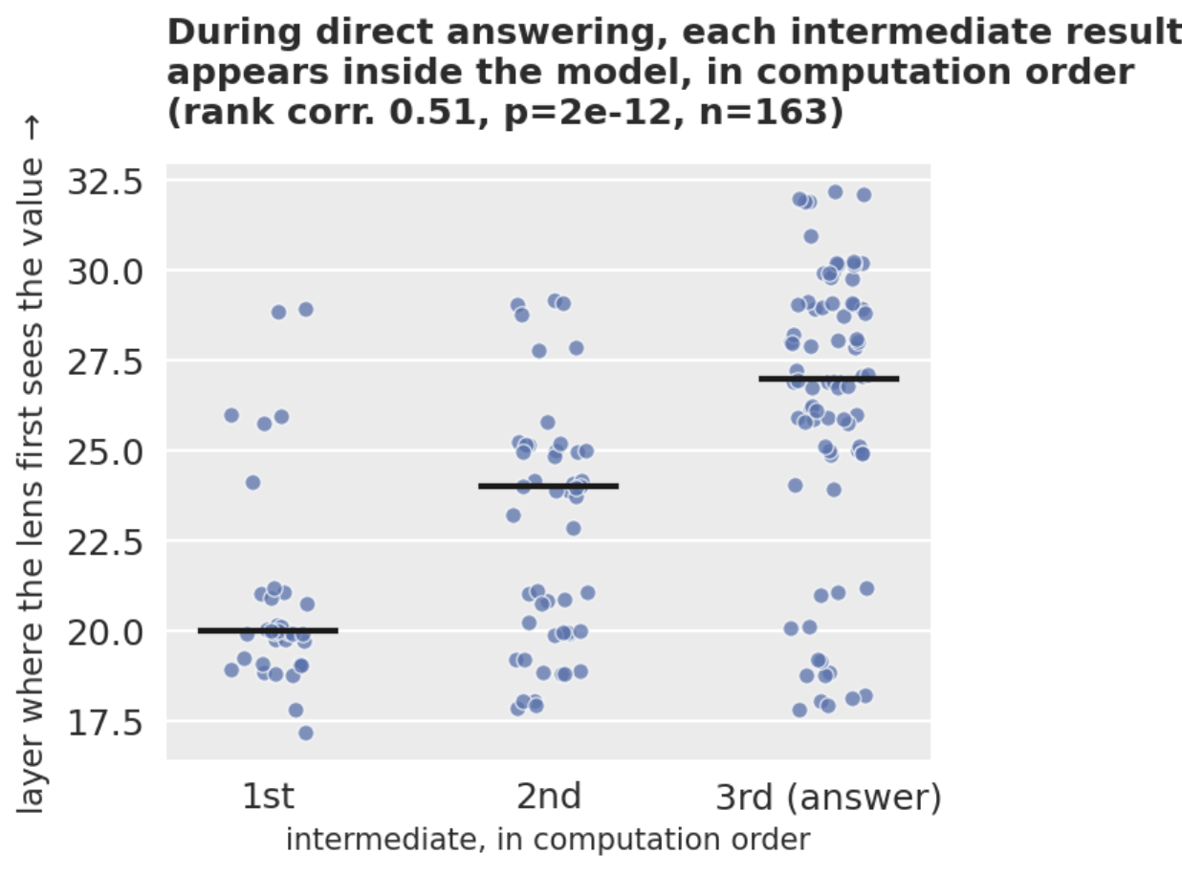
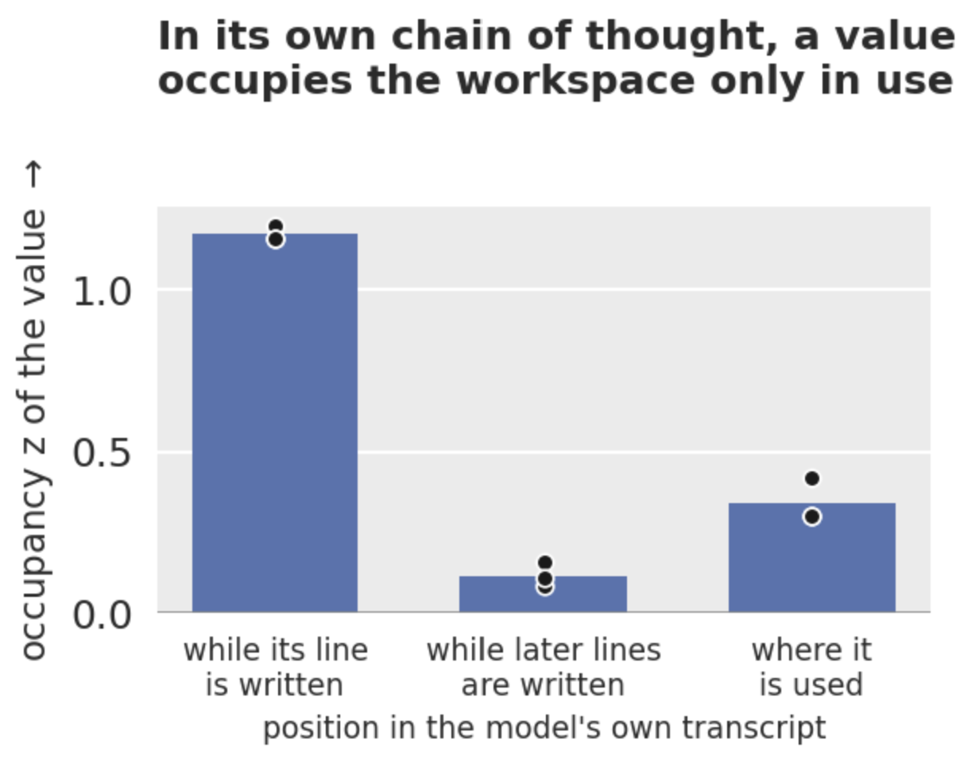
Duplication

Slide 16
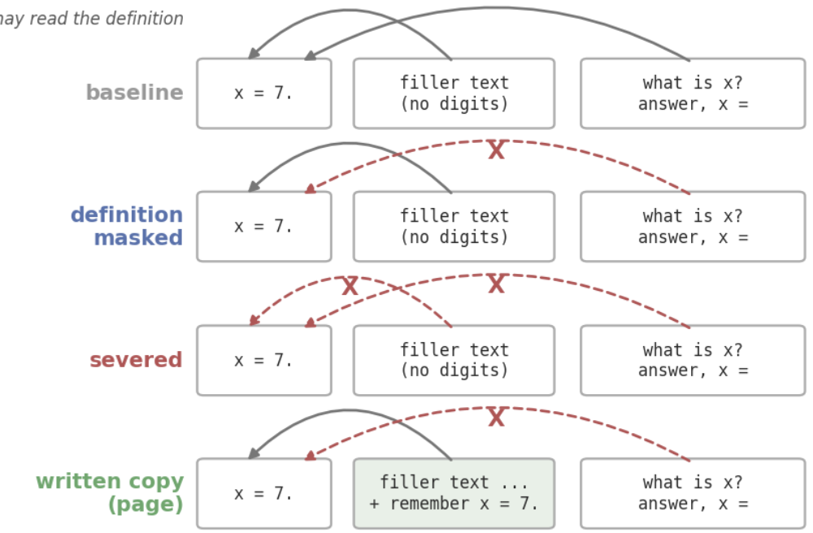
Does the internal workspace store values over time?
Attention masking to prevent read-access of the prompt tokens

Slide 17
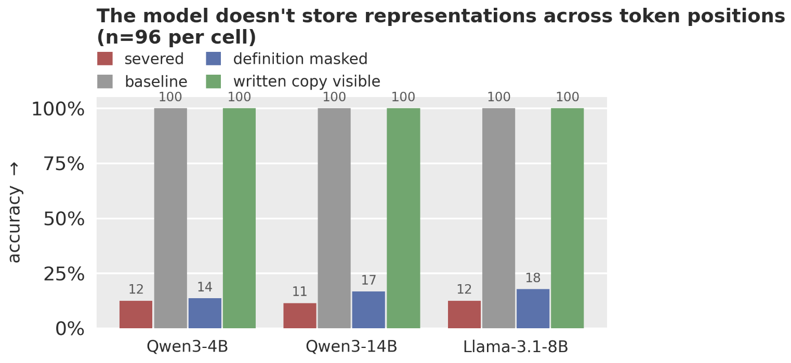
Does the internal workspace store values over time?

Slide 18
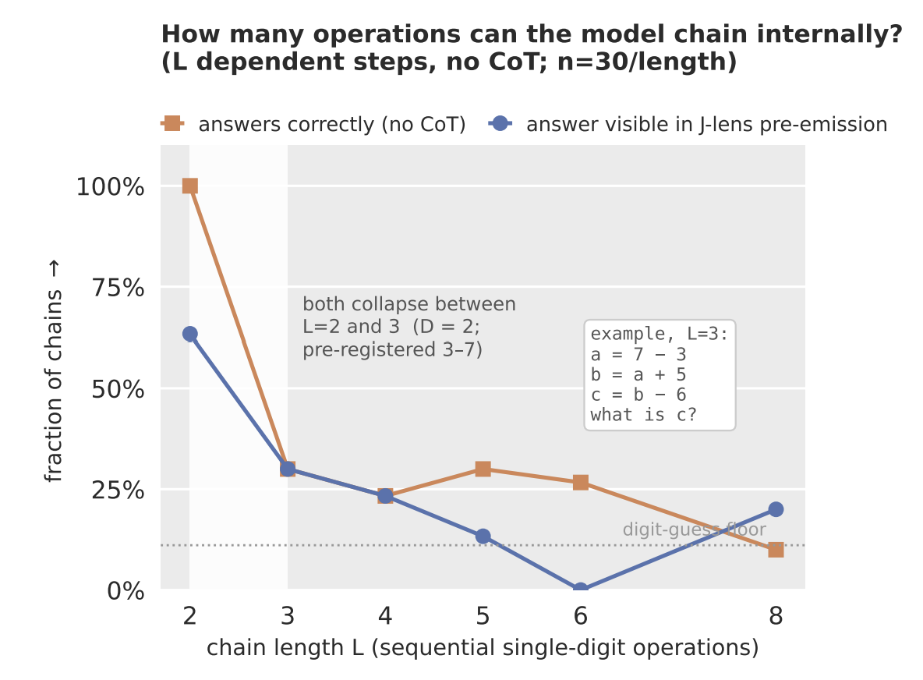
Direct reasoning cannot reason across large logical steps

Slide 19
Conclusions
The internal scratchpad as an input/output buffer for simple intermediate reasoning?
  1. Qwen3-4B can only internally chain 2 operations
  2. A value only occupies workspace when being used or about to be used
  3. No durable memory measured
Externalisation likely encourages exchange

Slide 20
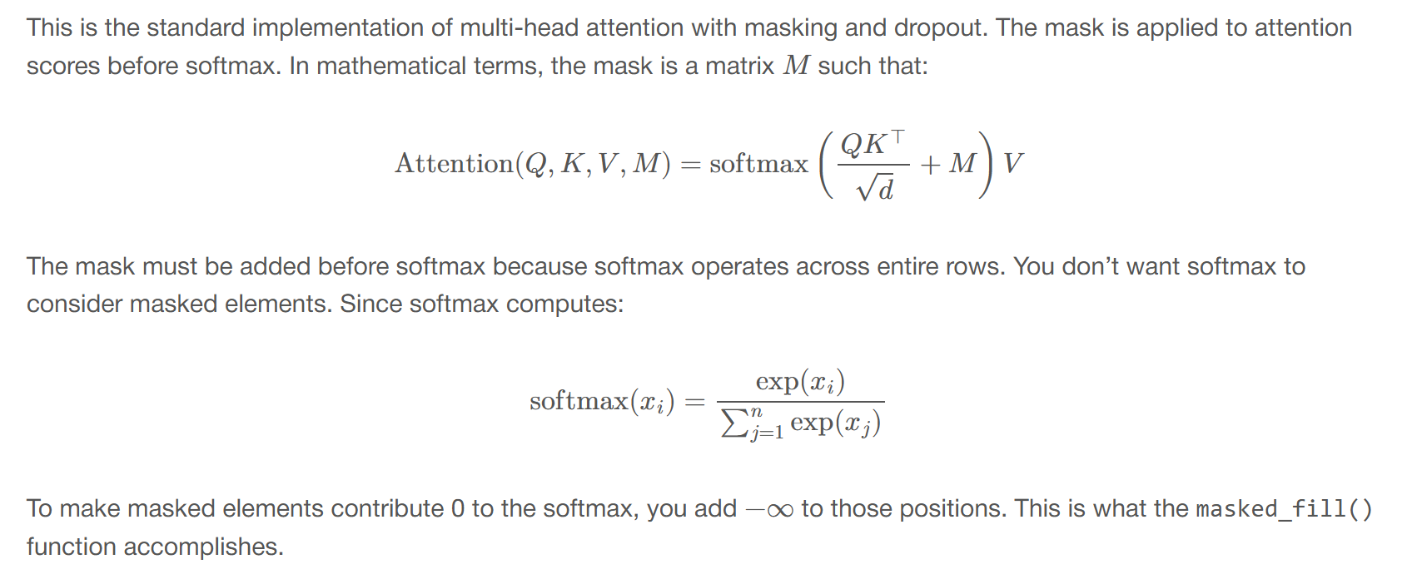
Appendix: Attention Masking

Slide 21
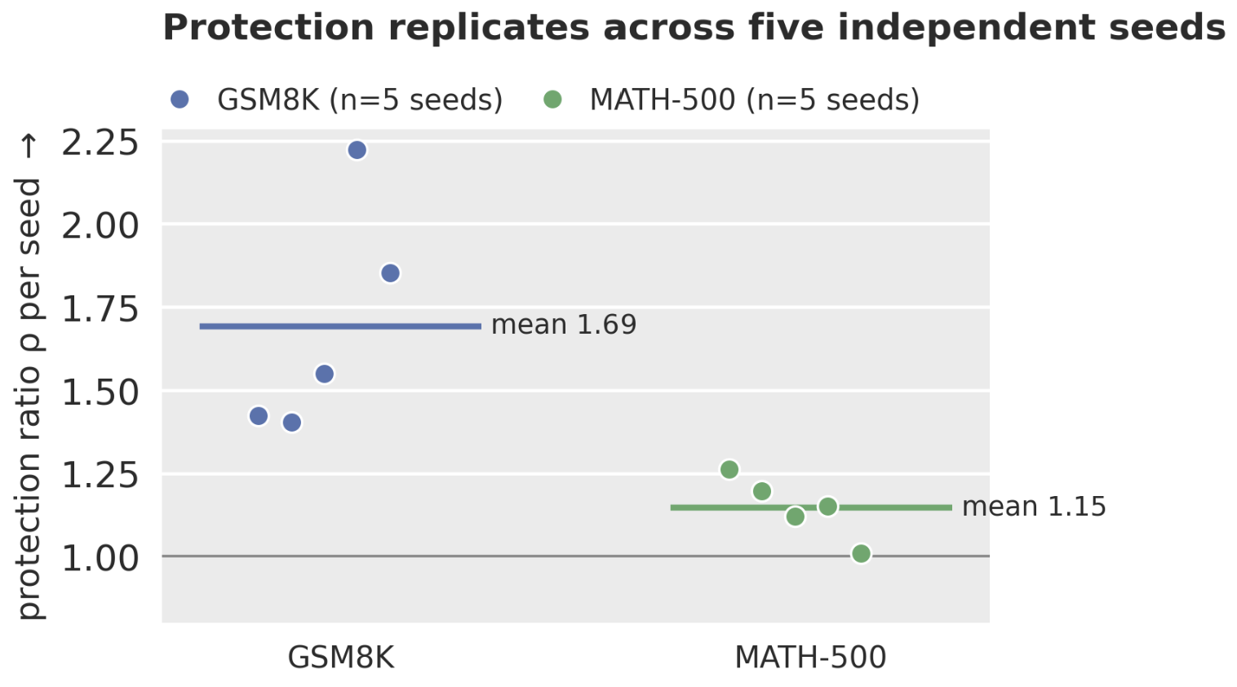
Appendix: Ablation Protection at n = 5 seeds

